Slide 1
Learning Translation Templates from Bilingual Translation Examples
Source: Applied Intelligence, 2001
Authors: Ilyas Cicekli and H. Altay Guvenir
Reporter: 江欣倩
Professor: 陳嘉平

Slide 2
Outline
Introduction
Translation Template Learner
System Architecture
Conclusion

Slide 3
Outline
Introduction
Translation Template Learner
System Architecture
Conclusion

Slide 4
Introduction
Example-based machine translation (EBMT)
  Main idea
    A given input sentence in the source language is compared with the example translations in the given bilingual parallel text to find the closest matching examples
  Exemplars
    The characteristic examples are stored in the memory
  Template
    An example translation pairs

Slide 5
Introduction
This paper
  Use stem and morphemes to describe pairs
    they are running <-> kosuyorlar
    they are walking <-> yuruyorlar
    they are run+PROG <-> kos+PROG+3PL
    they are walk+PROG <-> yuru+PROG+3PL
  Learn translation templates from translation examples and store them as generalized exemplars
    Translation Template Learner
      Similarity translation template learning
        they are X¹+PROG <-> X²+PROG+3PL
        if X¹ <-> X²
        run <-> kos
        walk <-> yuru
      Difference translation template learning
        X¹ run X² <-> kos X² X³
        they <-> +3PL
        +PROG <-> +PROG

Slide 6
Outline
Introduction
Translation Template Learner
System Architecture
Conclusion

Slide 7
Translation Templates
A translation template is a generalized translation exemplar pair.
  Replace some components with variables
Atomic translation templates do not contain any variable

Slide 8
Translation Template Learner
Similarity translation template learning (STTL)
  The similar parts in sentence pairs must be translations
Difference translation template learning (DTTL)
  The remaining differing constituents in source and target sentences are matched if the sentences have similarities

Slide 9

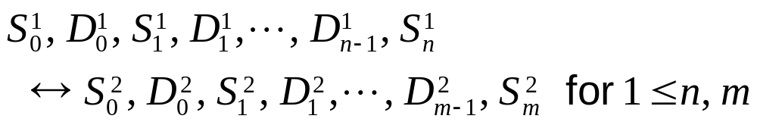

Translation Template Learner
two translation examples (E_{a}, E_{b})
  a translation example E_{a}:
  (D₁, D₂): a difference between two sentences of a language
  (S₁, S₂): a similarity between two sentences of a language
  M_{a,b}: match sequence
    : a similarity (a sequence of common items)
      at least one similarity on each side must be non-empty
M_{a,b}W DV: a new match sequence in M_{a,b} which all differences are replaced by proper variables
M_{a,b}W SV: a new match sequence in M_{a,b} which all similarities are replaced by proper variables

Slide 10
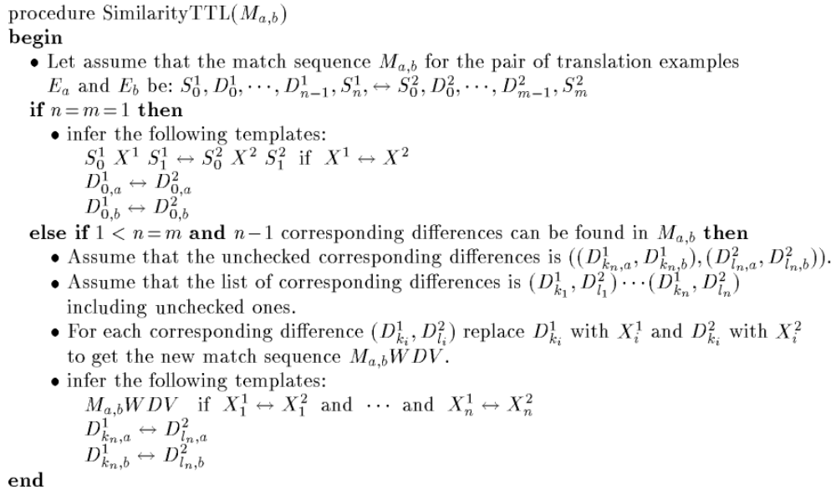
Similarity Translation Template Learning

Slide 11
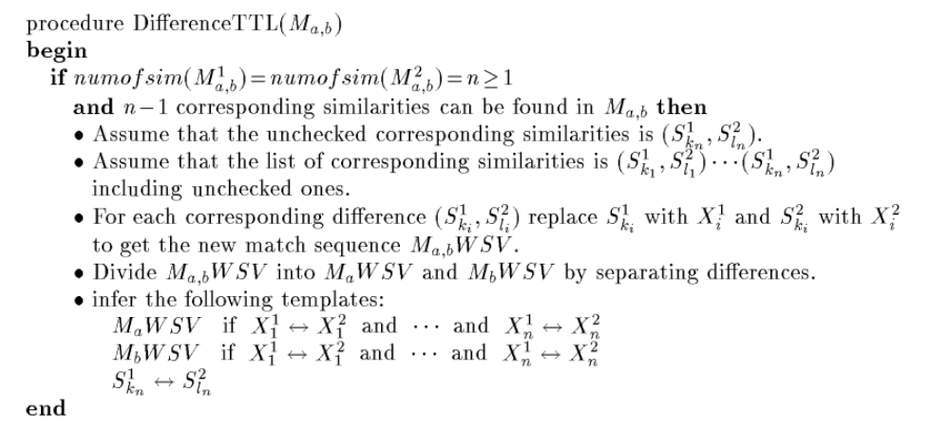
Difference Translation Template Learning

Slide 12
Different Number of Similarities or Differences in Match Sequences
i came <-> geldim
you went <-> gittin
i come+PAST <-> gel+PAST+1SG
you go+PAST <-> git+PAST+2SG
Match Sequence
(I come, you go) +PAST
<-> (gel,git) +PAST (+1SG,+2SG)
try to make the number of differences to be equal on both sides of a match sequence by separating differences before STTL algorithm

Slide 13
Differences Separating
Match Sequence
(i come, you go) +PAST
<-> (gel,git) +PAST (+1SG,+2SG)
Divide both constituents of difference into two parts from morpheme boundaries
(i,you) (come,go) +PAST
<-> (gel,git) +PAST (+1SG,+2SG)

Slide 14
Differences with Empty Constituents
i see+PAST the man
<-> adam+ACC gor+PAST+1SG
i see+PAST a man
<-> bir adam gor+PAST+1SG
Let a difference to have an empty constituent
i see+PAST (the:a) man
<-> (ε:bir) adam (+ACC:ε) gor+PAST+1SG

Slide 15
Examples
i come+PAST <-> gel+PAST+1SG
you come+PAST <-> gel+PAST+2SG
X¹ come+PAST <-> gel+PAST X²
if X¹ <-> X²
i <-> +1SG
you <-> +2SG
i X¹ <-> X² +1SG if X¹ <-> X²
you X¹ <-> X² +2SG if X¹ <-> X²
come+PAST <-> gel+PAST

Slide 16
Performance Results
Training set
  747 English and Turkish pairs
  Manually Tagging
 | Only STTL | Only DTTL | STTL+ DTTL | STTL+ DTTL+ Divide | STTL+ DTTL+ Divide+ Empty
Number of templates | 642 | 812+6 | 1239+6 | 1330+11 | 2055+55
Time cost (s) | 53 | 54*2 | 81*2 | 101*2 | 170*2

Slide 17
Outline
Introduction
Translation Template Learner
System Architecture
Conclusion

Slide 18
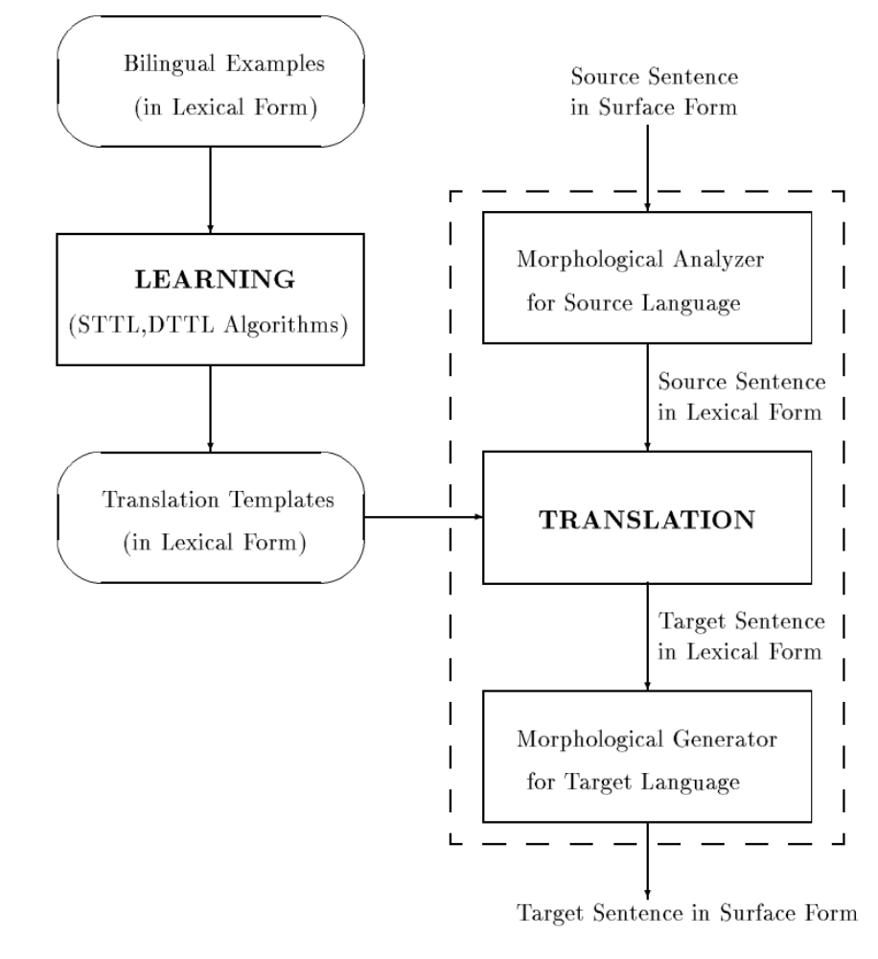
System Architecture

Slide 19
Evaluation
Goal
  accomplish top results contain correct translation
Order
  statistical method
  specify order according to the source language
    a higher number of terminals is more specific than the other
 | Confidence Method | Specify order of templates (Top 5) | Specify order+ Statistical method of templates | Specify order of translation (Top 5) | Specify order+ Statistical method of translation
accuracy | 33% | 44% | 60% | 77% | 91%

Slide 20
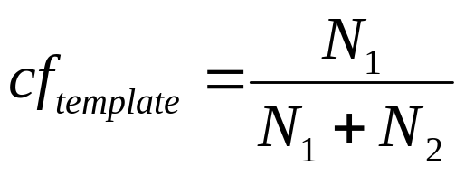
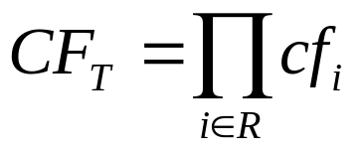
Statistical Method
Confidence of templates
  N₁: the number of training pairs where X is a substring of X_{i} and Y is a substring of Y_{i}
  N2: the number of training pairs where X is a substring of X_{i} and Y is not a substring of Y_{i}
Confidence of translations
  R: the set of rule generates the translation

Slide 21
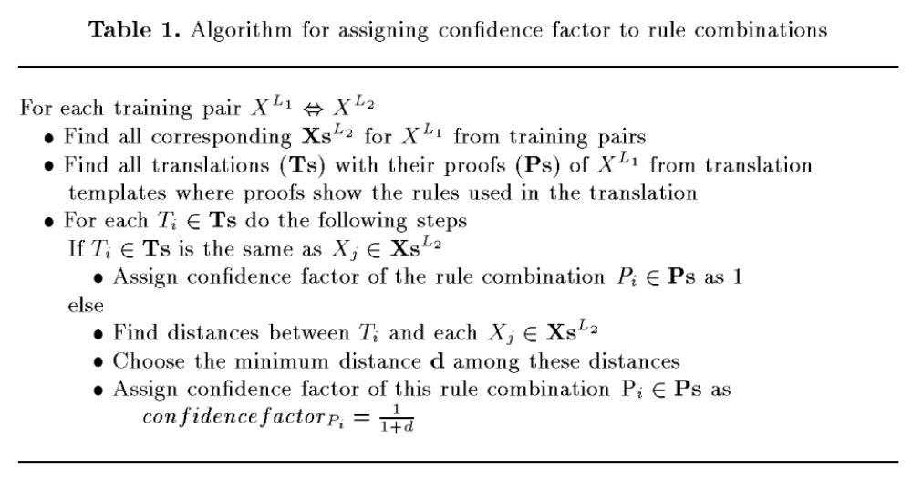
Confidence Method

Slide 22
Outline
Introduction
Translation Template Learner
System Architecture
Conclusion

Slide 23
Conclusion
The major contribution is that the proposed TTL algorithm eliminates the need for manually encoding the translation templates.

